Slide 1
Building a Line-Bot:
Ctrl+Alt+Elite

Slide 2
List of Materials
Components
Arduino
Mini-Breadboard
H-bridge
2 Wheels + Gearboxes
M/F Jumper Wires
M/M Jumper Wires
9V Battery
9V Battery cable
Ball bearing
Foam square (10cm x 12cm)
Ultrasonic Sensors
IR Sensors
Tools
Scissors
Double sided tape

Slide 3
Learning objectives
By the end of this unit, you should be able to
Integrate sensors into projects
Use knowledge learned in previous units to build a car that will follow a designated path and stop before running into an obstacle

Slide 4
Section 1:
Sensor Review

Slide 5
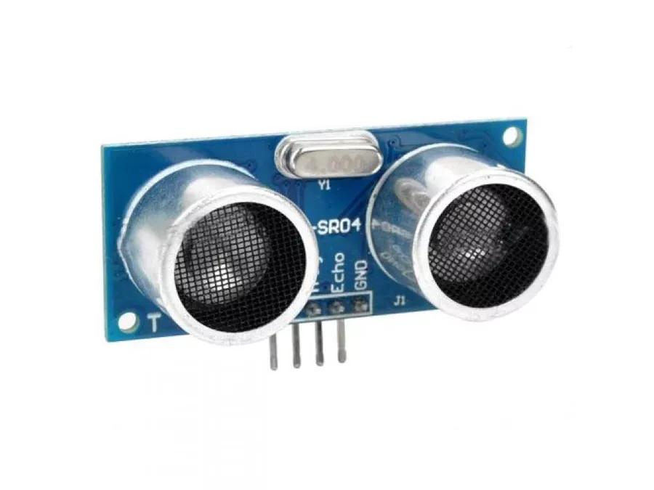
Sensor Review
Ultrasonic Sensor:
What does it do?
How does it work?

Slide 6
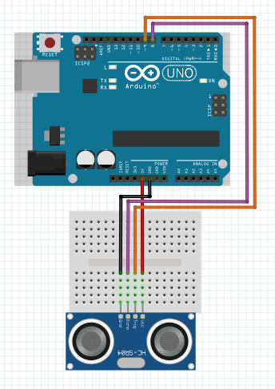
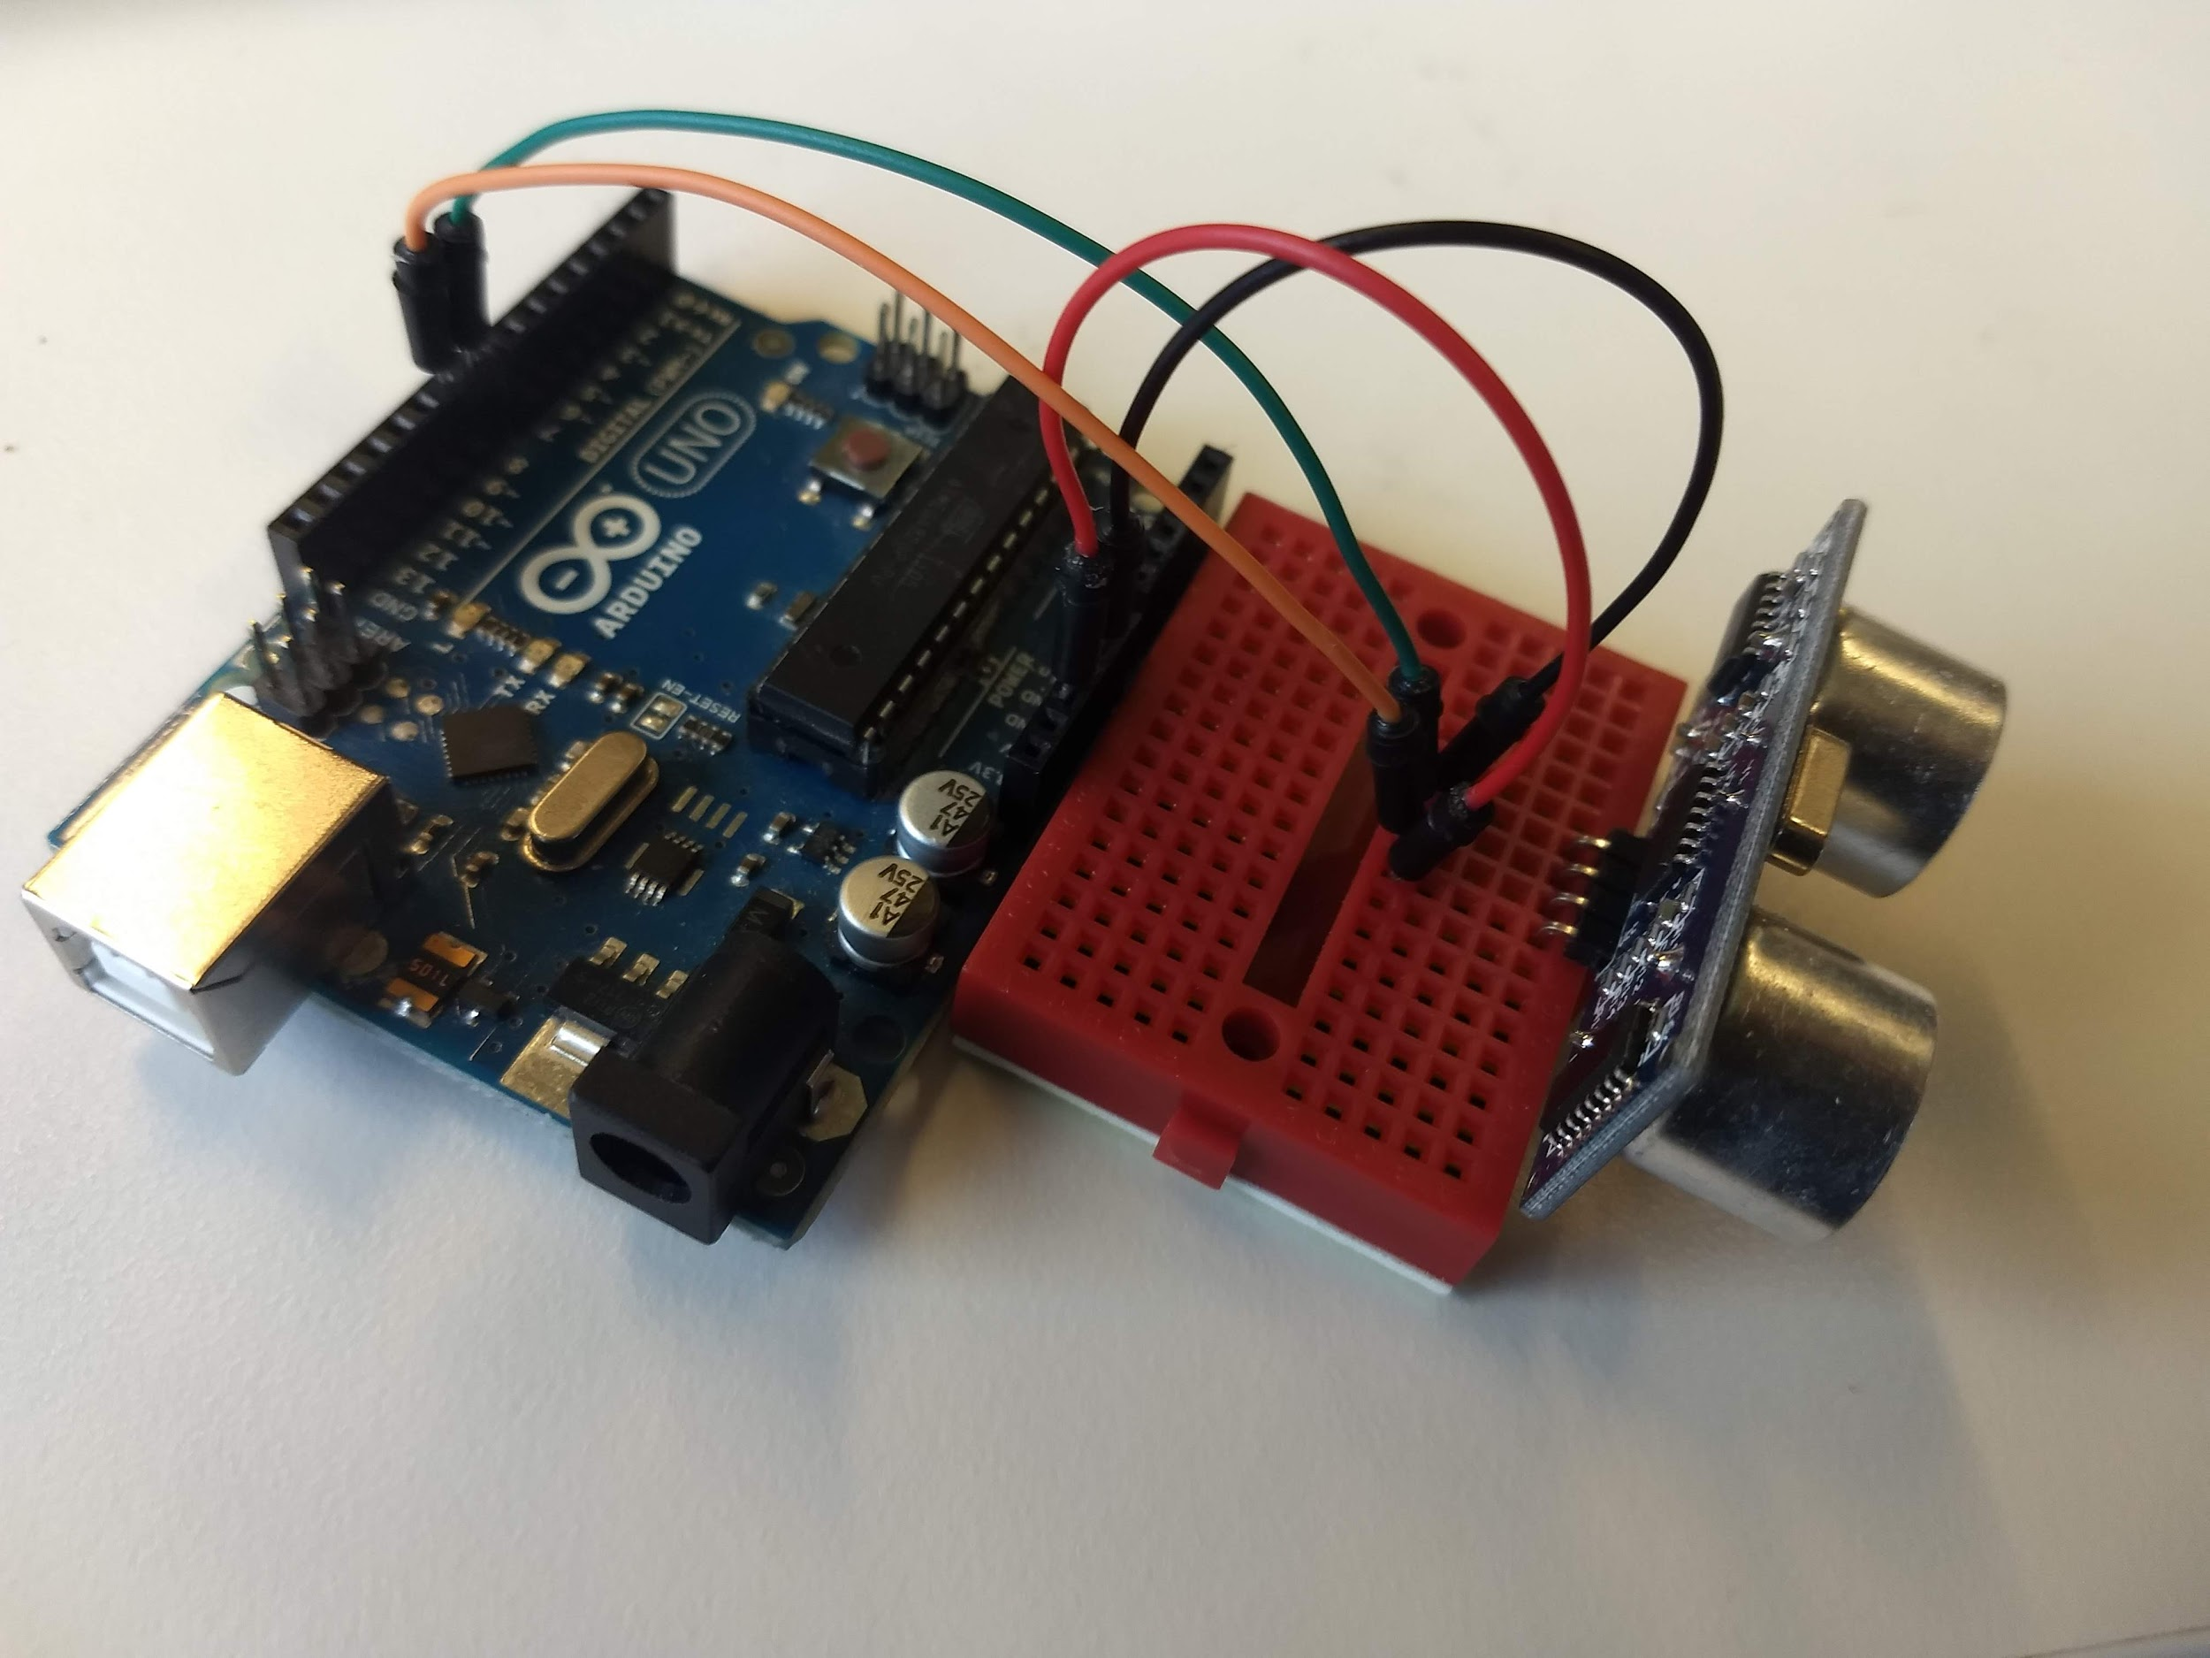
Sensor Review
Ultrasonic Sensor:
Let’s start by building the circuit
Note: Ultrasonic may be backwards depending on how attached to breadboard. Make sure to always check the labels on the pins of the sensor

Slide 7
Sensor Review
Ultrasonic Sensor:
Programming the Ultrasonic Sensor
Declare pins as variables
const int Ultra_trig = 9;
const int Ultra_echo = 8;
In setup
pinMode(Ultra_echo, INPUT);
pinMode(Ultra_trig, OUTPUT);
Serial.begin(9600);
Notes:
Solution: IR-Sensor

Slide 8
Sensor Review
Ultrasonic Sensor:
Programming the Ultrasonic Sensor
digitalWrite(Ultra-trig, LOW);
delayMicroseconds(2);
digitalWrite(Ultra_trig, HIGH);
delayMicroseconds(10);
digitalWrite(Ultra_trig, LOW);
duration = pulseIn(Ultra_echo, HIGH);
distance = duration*0.034/2
Serial.print(“Ultrasonic (cm): “);
Serial.print(distance);
Serial.print(“\n”);
Notes:
Solution: IR-Sensor

Slide 9
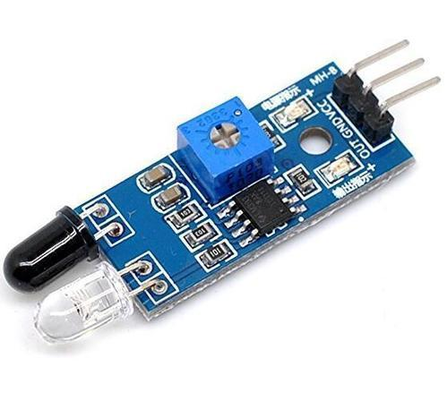
Sensor Review
IR Sensor:
What does it do?
How does it work?

Slide 10
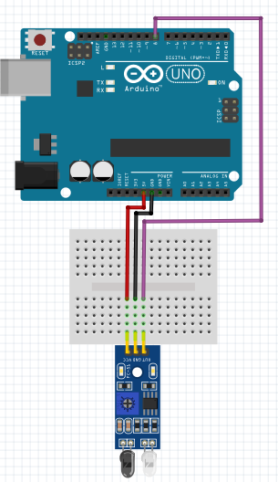
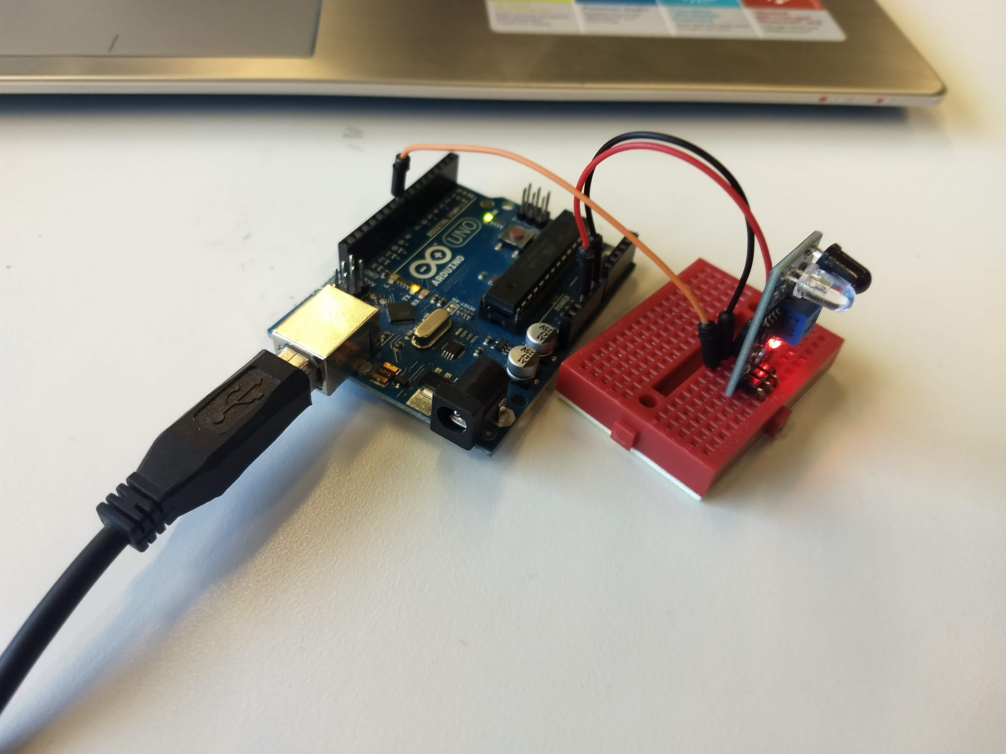
Sensor Review
IR Sensor:
Let’s start by building the circuit

Slide 11
Sensor Review
IR Sensor:
Programming the IR Sensor
Declare pin as variable: int IR_sensor = 8;
In setup
pinMode(IR_sensor, INPUT);
Serial.begin(9600);
In loop
Serial.print("IRSensor: ");
Serial.print(digitalRead(IR_sensor));
Serial.print("\n");
Notes:
Solution: IR-Sensor

Slide 12
Section 2:
Building a Linebot

Slide 13
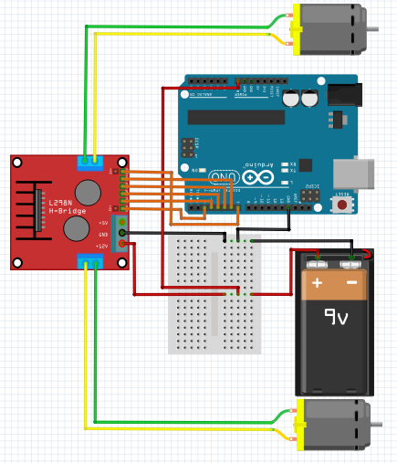
Assembly
Remember the Car we built?
Let’s start by building that again
Notes:
If necessary, please refer to Unit 4: Building a car to review how to build the car

Slide 14
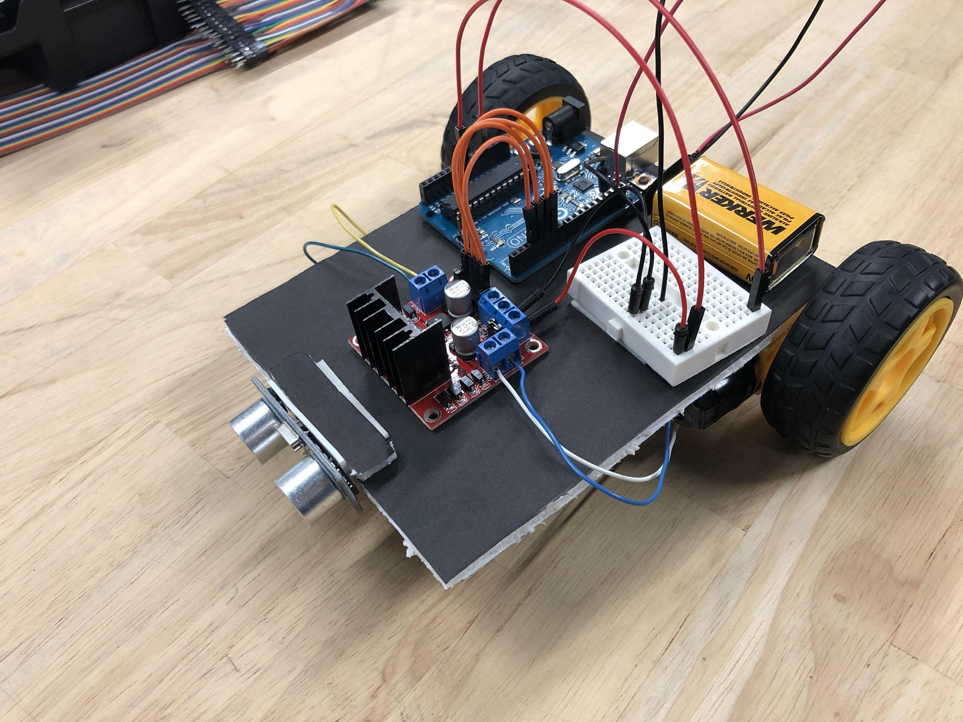
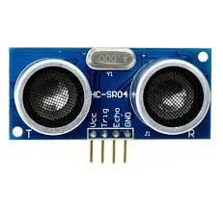
Assembly
Attach the Ultrasonic Sensor to the front

Slide 15
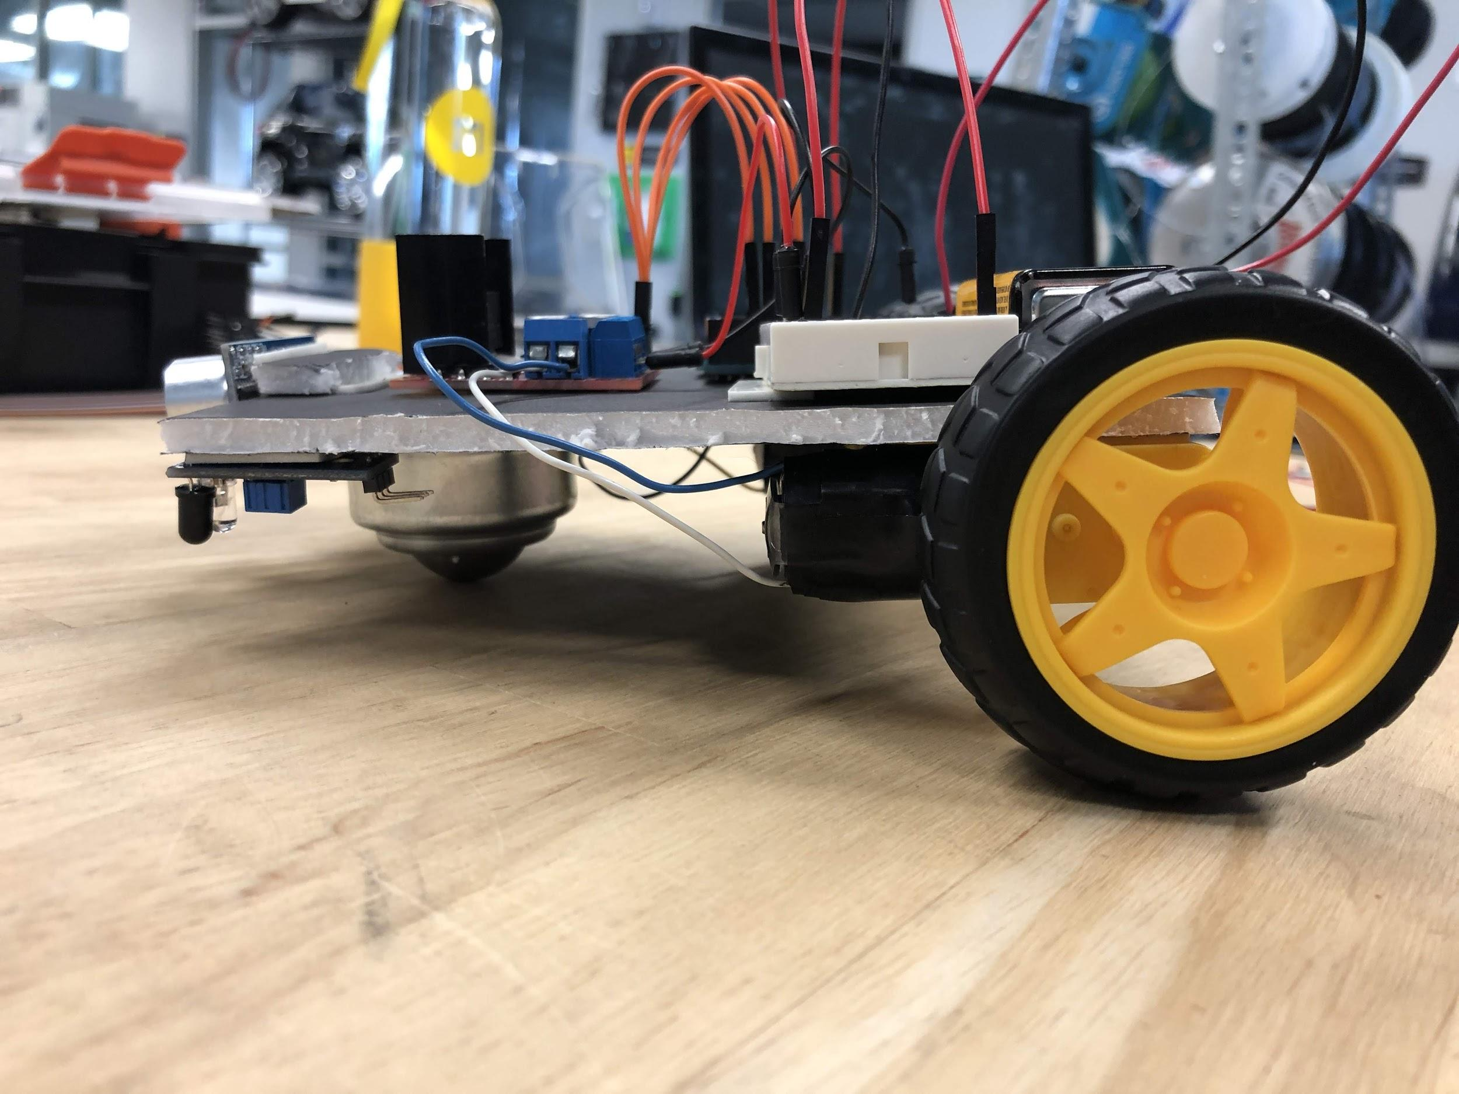
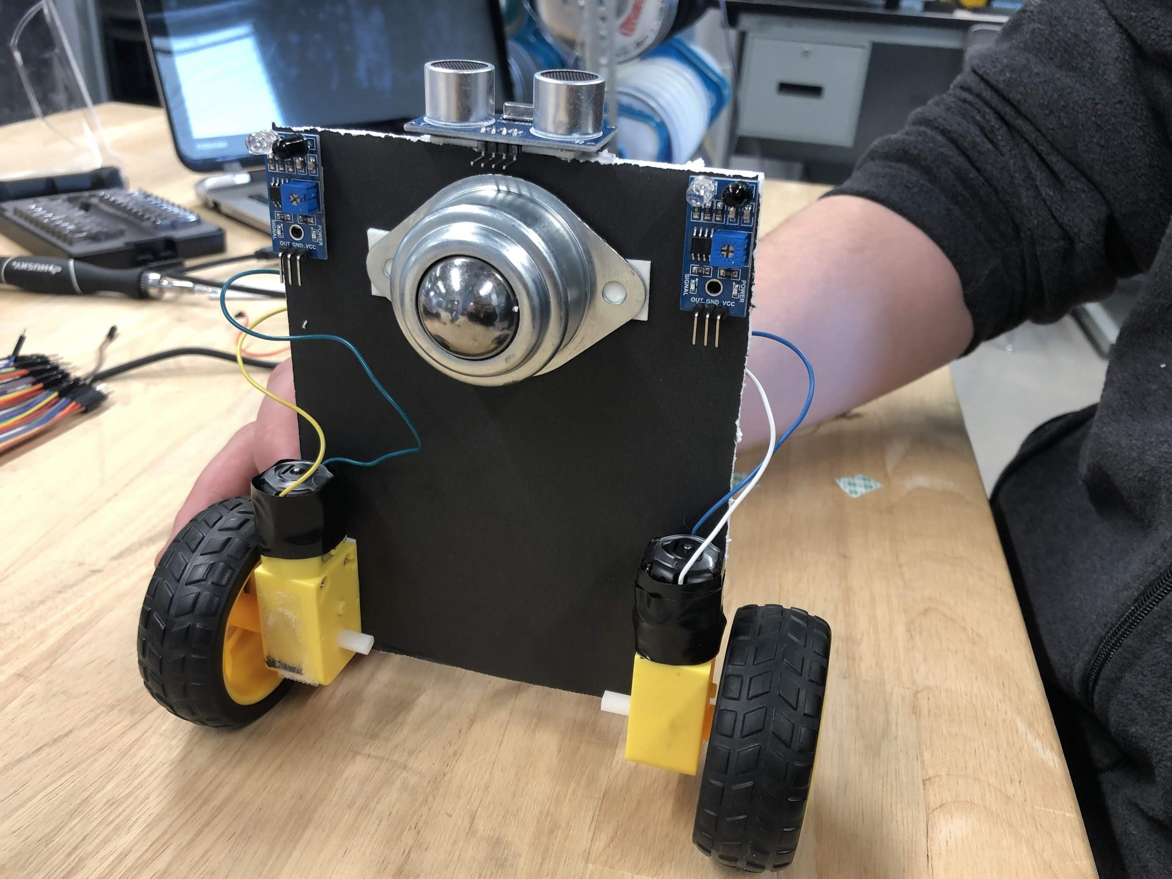
Assembly
Attach the IR Sensors to the bottom of either side, on the front

Slide 16
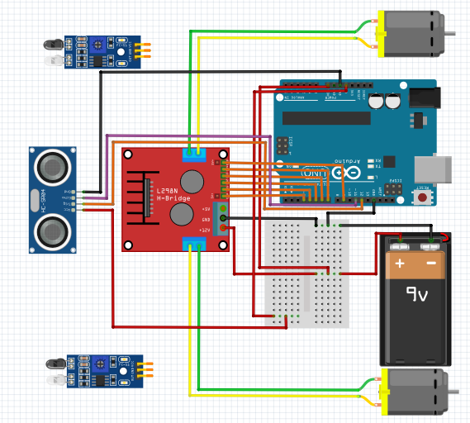
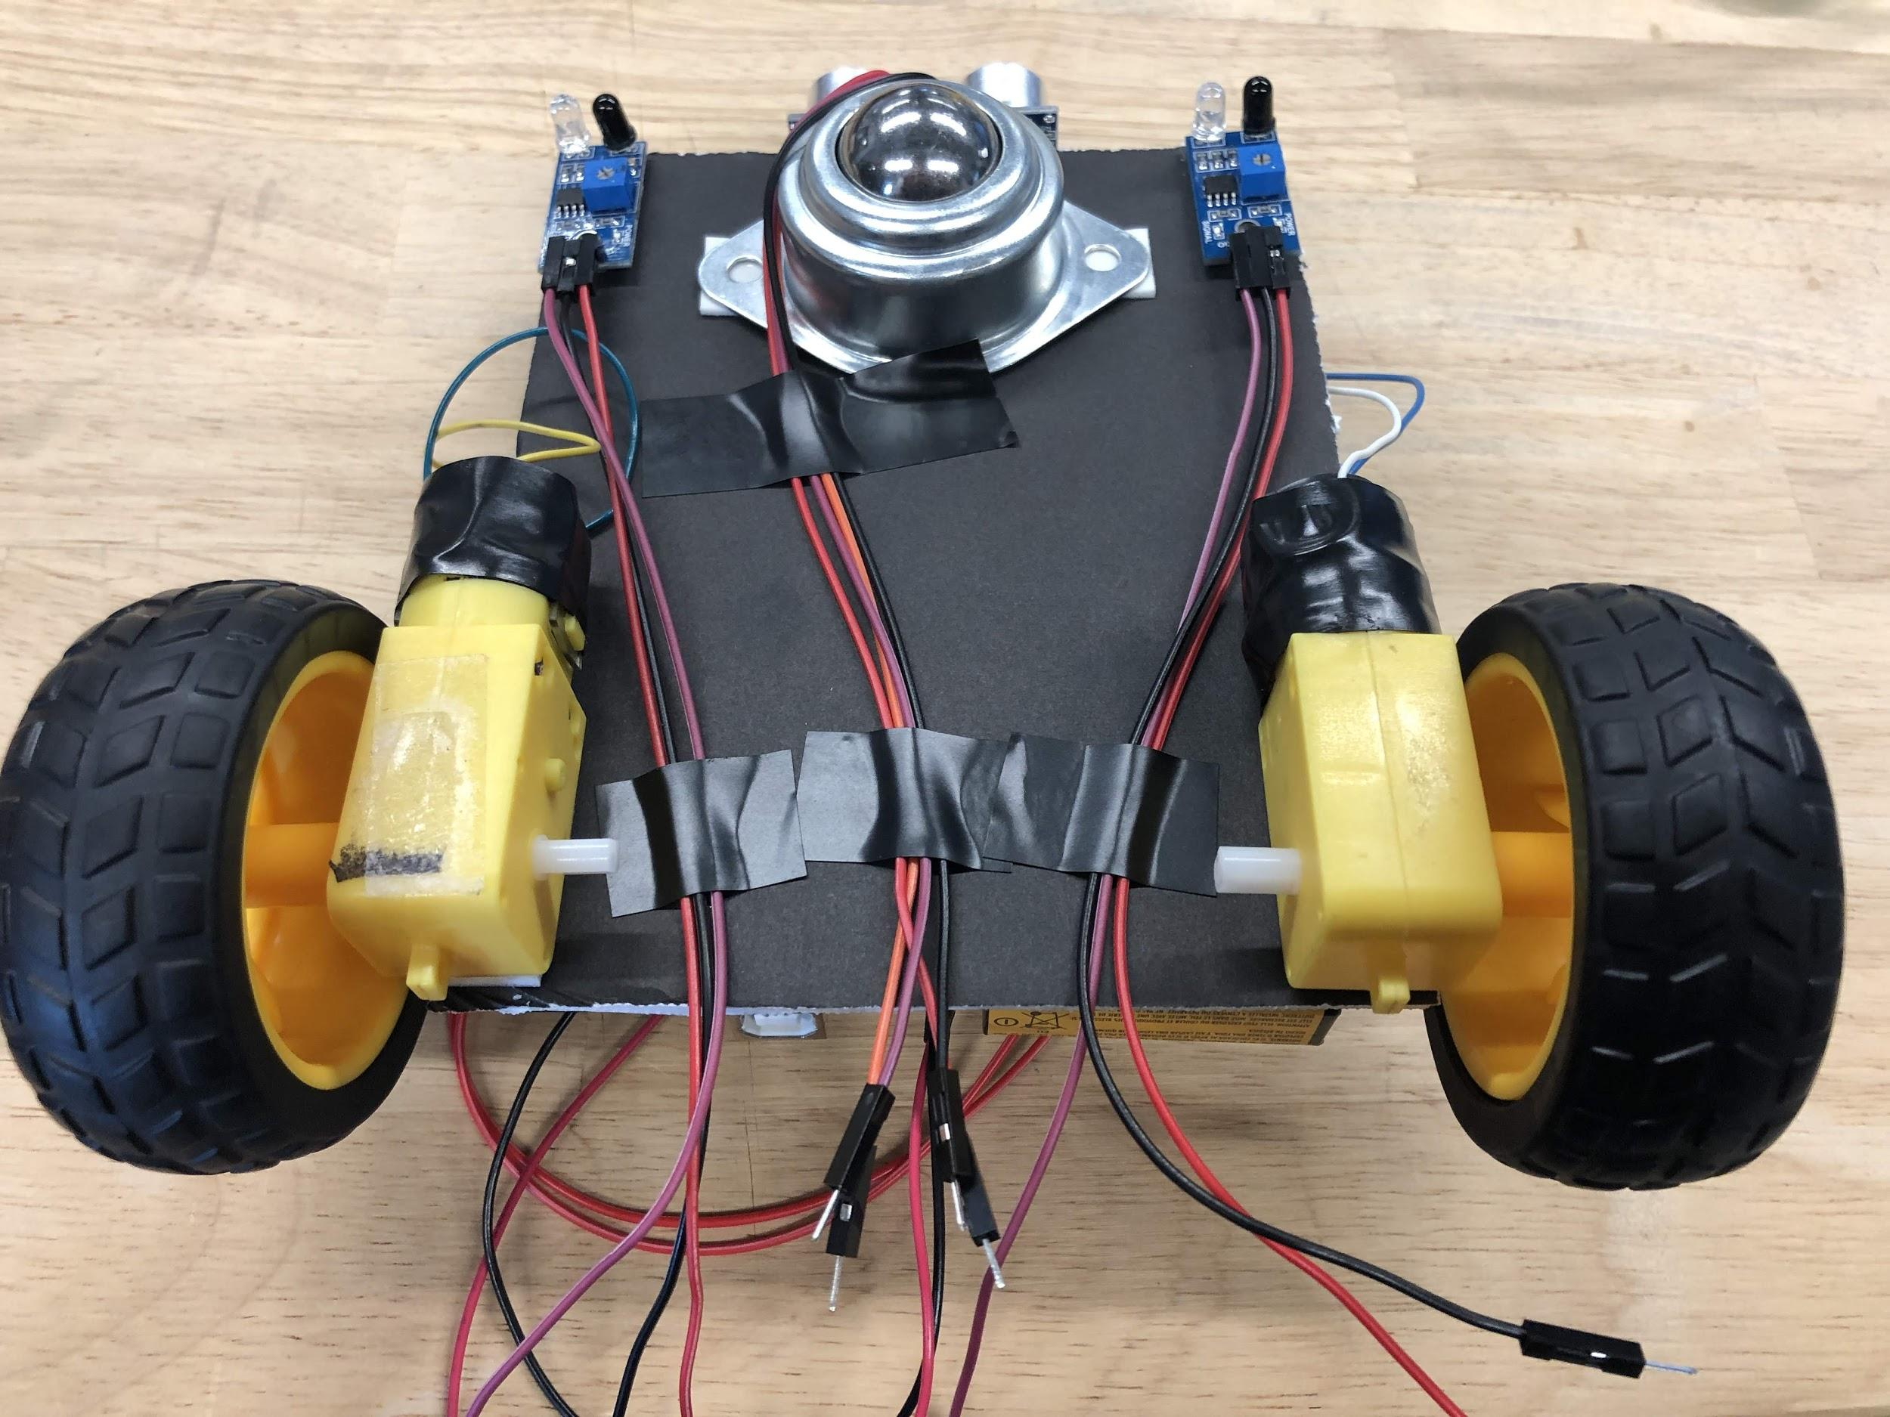
Wiring
Attach the Ultrasonic Sensor to the Arduino

Slide 17
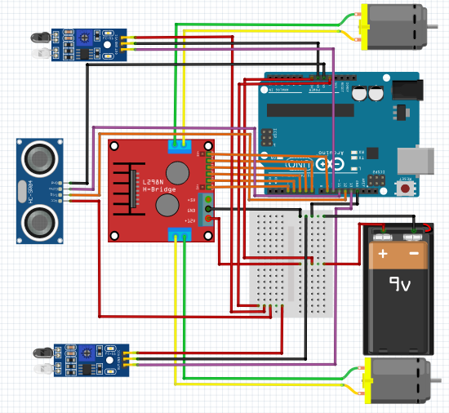
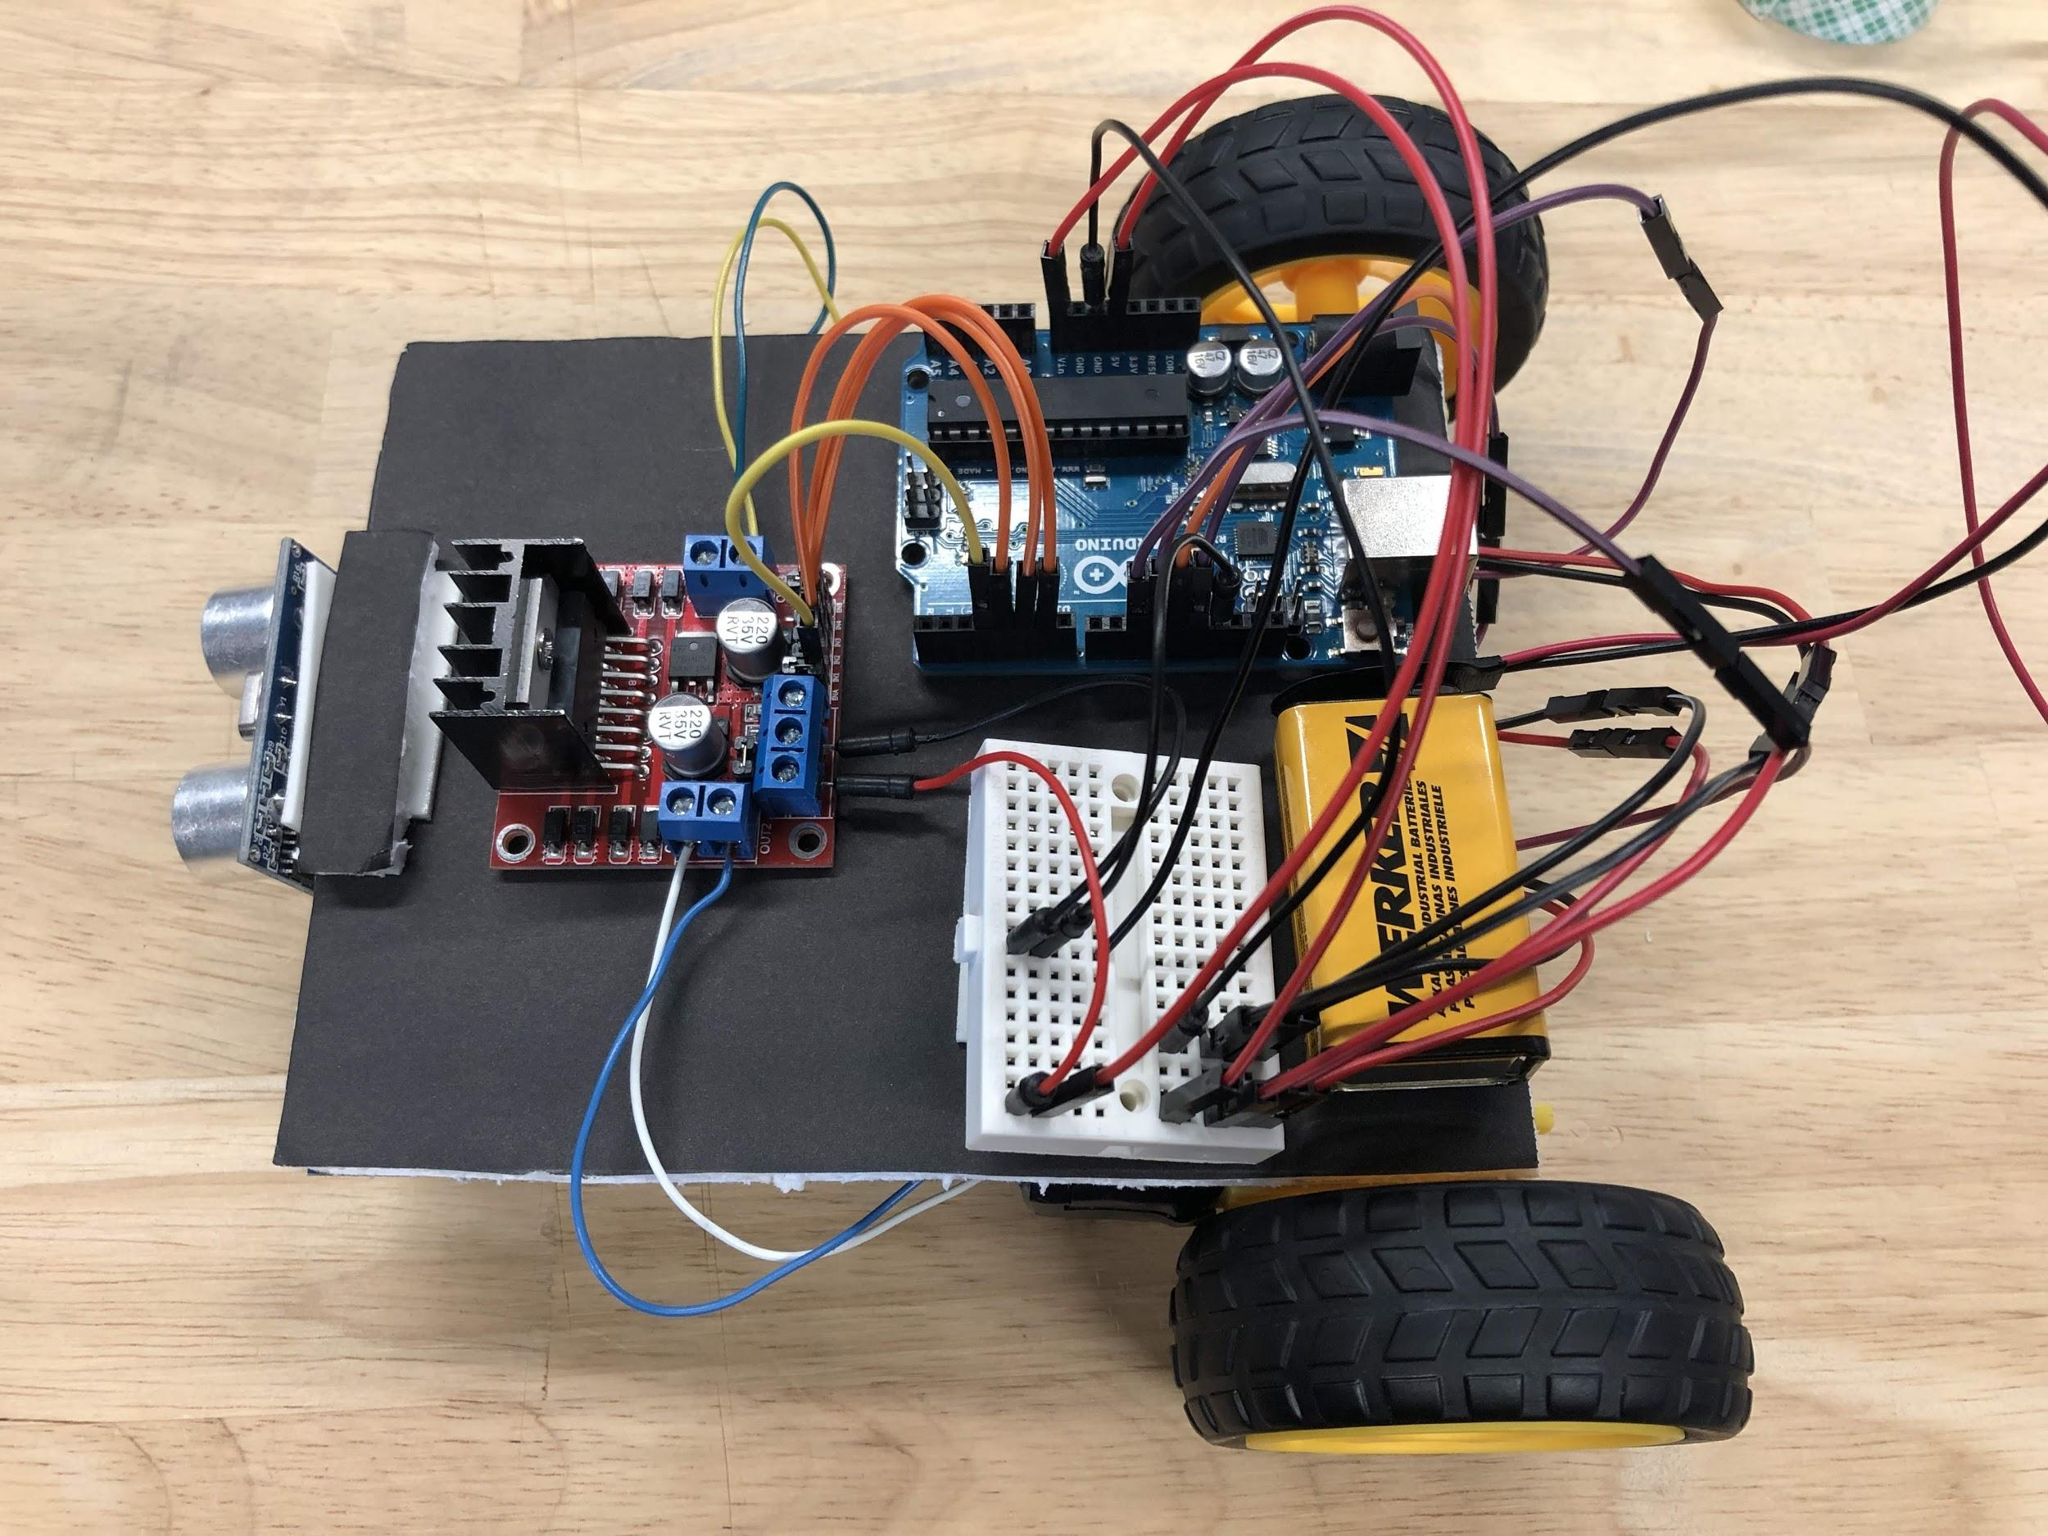
Wiring
Attach the IR Sensors to the Arduino

Slide 18
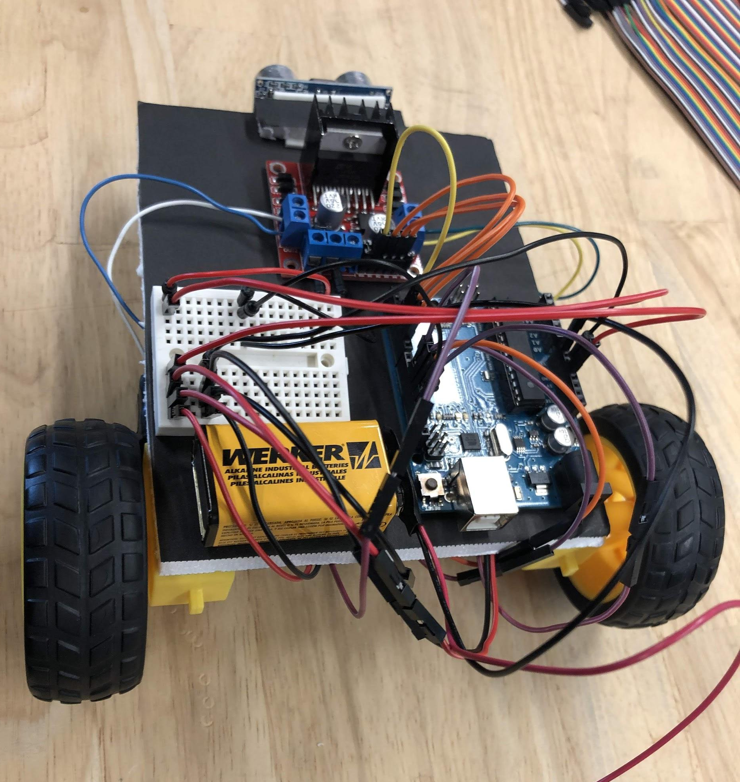
Completed Linebot

Slide 19
Programming
Logic:
We need to make sure the robot:
stays on the track
stops when it sees an obstacle in front of it
Write pseudo code for this program

Slide 20
Programming
Example Pseudo code sol’n
If nothing in front of robot
Run track program
Else
Stop robot

Slide 21
Programming
Example Pseudo code sol’n (cont)
Track program:
If both IR on track
Go forward
elseIf only left IR on track
Turn right
elseIf only right IR on track
Turn left
elseIf neither IR on track
Go backwards

Slide 22
Programming
Now using your Pseudo code, write the program for the Linebot
Notes:
Solution: Linebot

Slide 23
Variations
Try adding a potentiometer to control the speed of the wheels
Hint: use the map function
analogRead: 0-1023
analogWrite(using PWM pin): 0-255

Slide 24
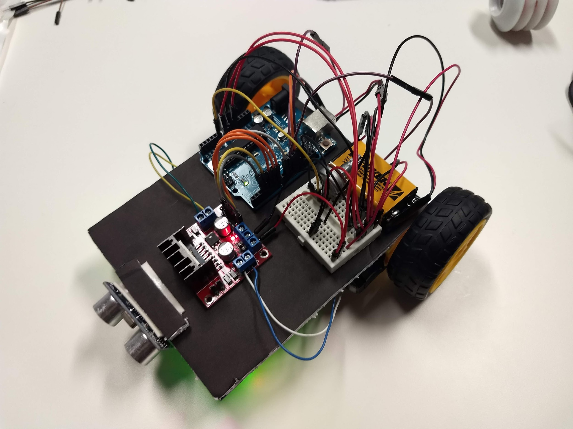
Variable speed (Assembly)
Connect potentiometer breadboard

Slide 25
Variable speed (wiring)
Connect potentiometer to 5V, GND, and analogIn

Slide 26
Variable speed (Programming)
In setup: Declare variable for potentiometer value:
int pot_val;
In loop:
pot_val = analogRead(A0);
pot_val = map(pot_val, 0, 1023, 0, 255);
analogWrite(ENA, pot_val);
analogWrite(ENB, pot_val);
Notes:
Solution: Linebot_varspeed

